Slide 1
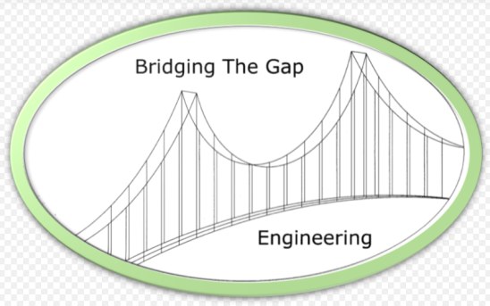
Bridging the Gap Engineering
BRANDON ADAMS
MICHAEL ASHWORTH
ZACH CUMM
BRANDON DIAL
NATASHA NAPIER
JOHN SKAGGS

Slide 2
Alternatives Summary
Comparison Criteria
Cost
Construction
Material
Shipping Limitations
100 feet shipping limit
Scheduling
Manufacturing Availability
Capacity Requirements
Alternatives
Steel Plate Girder
AASHTO Type V Concrete I-Beam
Steel Rolled Beam

Slide 3
Design Alt. #1
Steel Plate Girder
AASHTO M 270 (ASTM 709M) – Grade 50 Steel
F_{y} = 50 ksi
F_{u} = 65 ksi
4 plate girders
9.0 feet spacing (center-to-center)
2 ft – 10 in deck overhang
18 in x 20 in x 5.875 in elastomeric bearing pad (e-Span 140)

Slide 4
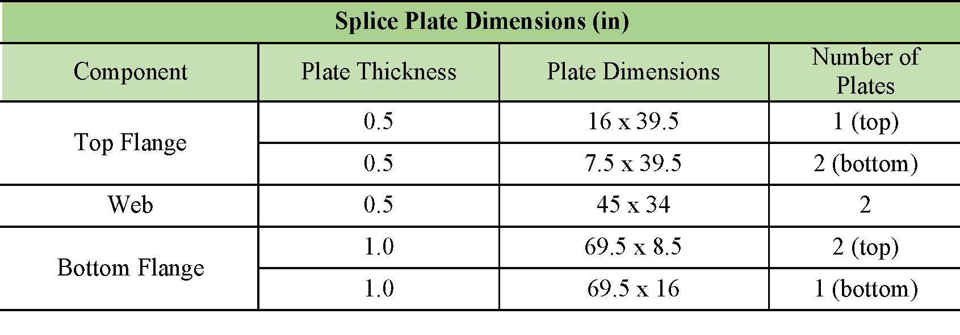
Design Alt. #1
Steel Plate Girder
Spliced at L = 100’ and L = 25’
AASHTO M 164 Type 3 Bolts
7/8 in diameter
328 bolts/beam x 4 beams = 1312 bolts total

Slide 5
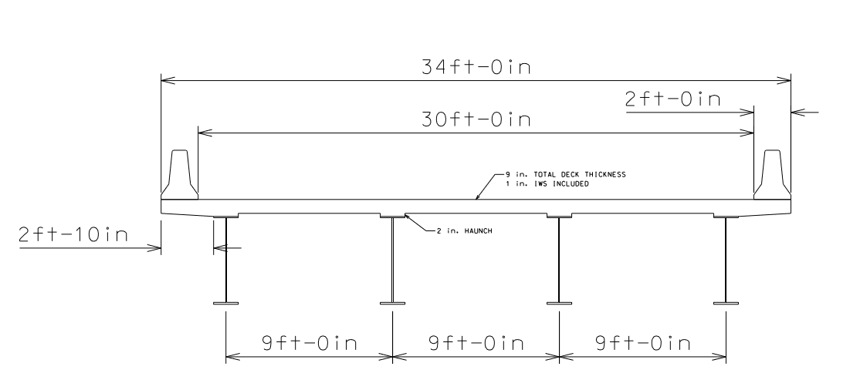
Plans
Steel Plate Girder Bridge Section

Slide 6
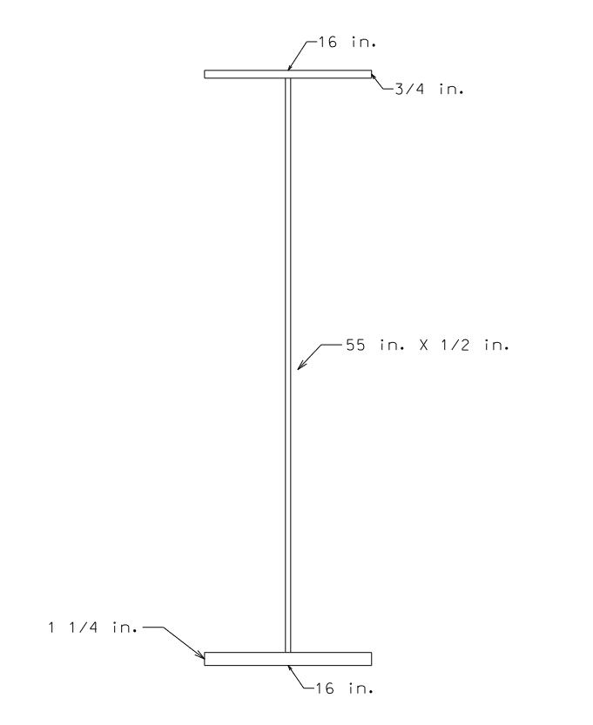
Plans
Steel Plate Girder Detail - Section

Slide 7
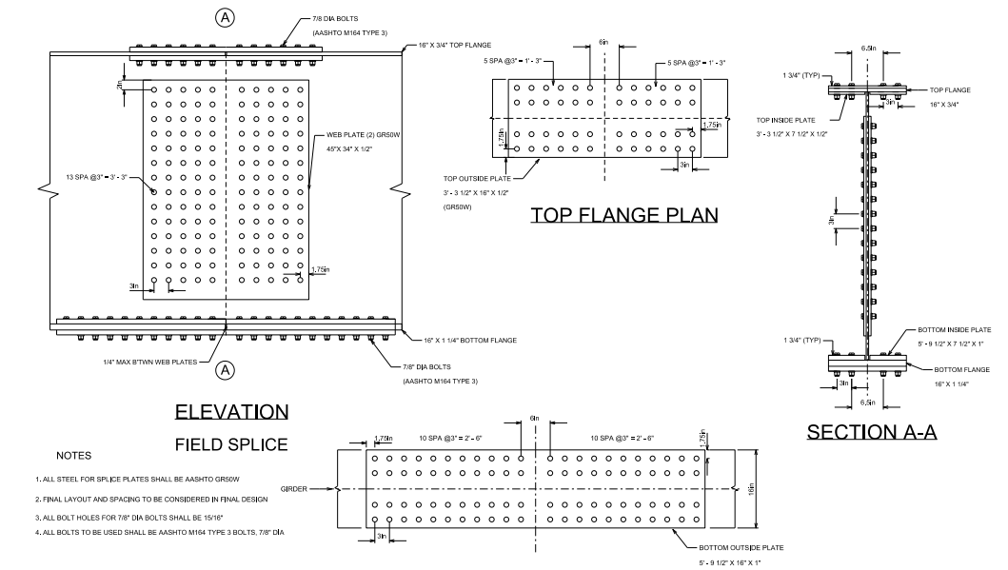
Plans
Connection Detail – Steel Alternatives

Slide 8
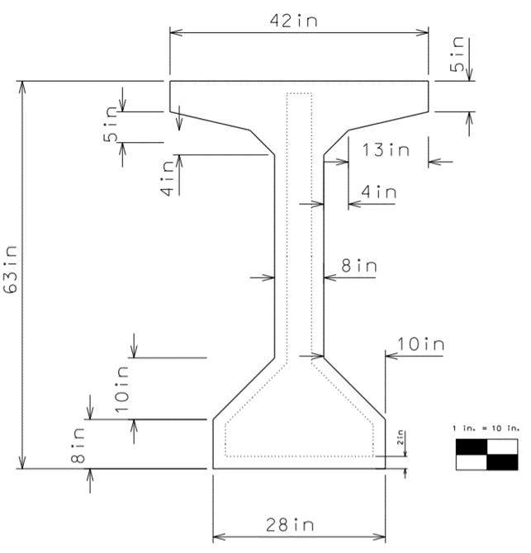
Design Alt. #2
AASHTO Type V Concrete I-Beam
4 girders
8.0 feet spacing (center-to-center)
125 feet span length
*Due to shipping limitations the concrete I-beam is not a feasible alternative.

Slide 9
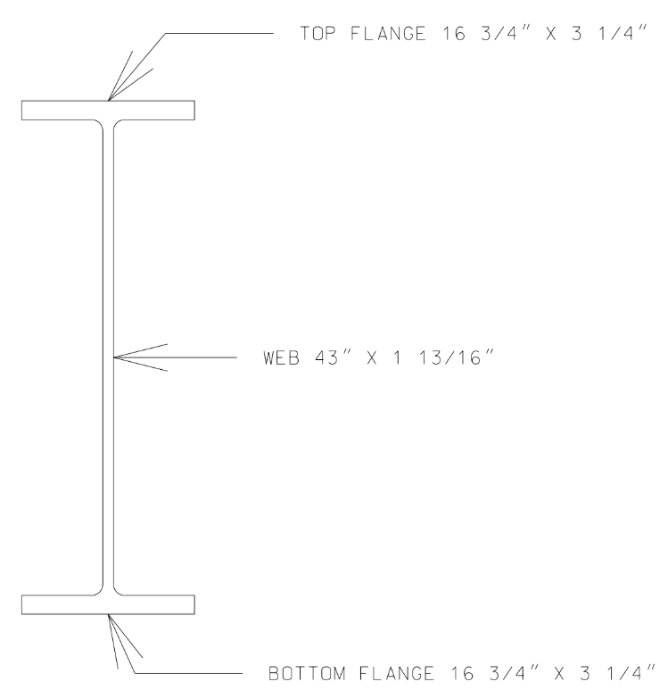
Design Alt. #3
Rolled Steel Beam (W Shape)
W40x593
4 Beams
9’ spacing
34” overhang
593lbs per foot.
Total weight = 148.5 tons
*The total weight of the rolled beam is greater than the plate girder. The rolled steel beam is a more expensive alternative.

Slide 10
Cost Assumptions
Excludes any features that have a consistent design & cost (deck, parapet wall, etc.)
Crane size calculated using an online crane calculator based off of weight and radius required.
Running percent of 15% on job office overhead (Primary Contractor), 15% on home office overhead (Primary Contractor), 10% on Profit (Primary Contractor), 2% on bond (Primary Contractor), and 6% on taxes (Project). 25% running percent for sub-contractor.
MII & RSMeans cost books used for any pricing that is not separately noted.
10% of girder cost estimated for shipping

Slide 11
Cost Comparison
Cost Comparison of Alternatives
Alternative | Direct Material Cost | Project Cost | Direct Cost
Steel Plate Girders | $215,000 | $445,000 | $295,000
AASHTO Type V Concrete I-Beam | $225,000 | $500,000 | $330,000
Steel Rolled Beam | $231,000 | $511,0o0 | $339,000
Steel Plate Girder Alternative was determined to be the cheapest with the next closest being 12% higher in cost
Difference between Steel Plate Girder and Rolled Steel Girder is significant enough ($45,000) to deem the Steel Plate Girder as a better choice from a cost perspective.

Slide 12
Alternative Selection
Selected Alternative:
Alternative #1 - Steel Plate Girder
Justification for Alternative #1:
Shipping length made the AASHTO Type V Beam Concrete I-Beams not feasible
Cost of the Rolled Beam alternative compared to the Plate Girder alternative was too high

Slide 13
Beam Optimizations
Calculated deflection limit
1.875”
Flange changes required
Top flange thickness increased from ¾” to 1 ½”
Bottom flange thickness increased from 1 ¼” to 1 ¾”
New optimized deflection
1.731”

Slide 14
Design Capacity
Design capacity
Ultimate Moment
10,215.625 foot-kips
Ultimate Shear
335.09 kips
Plastic moment (AASHTO Table D6.1-1)
10,924.141 foot-kips
Nominal moment (AASHTO 6.10.7.1.2)
10,601.84 foot-kips
Nominal moment > Ultimate moment
Moment Capacity Performance Ratio of 96%

Slide 15
Design Calculations
Shear capacity
Longitudinal stiffener required 55 inches from abutment
Nominal shear (AASHTO 6.10.9.3.2-2)
479.336 kips
Nominal Shear > Ultimate Shear
Shear capacity is adequate

Slide 16
Final Design
Final design contains
Four steel plate girders
Reinforced concrete deck
Diaphragms
Shear studs
Parapet wlls
Elastomeric bearings

Slide 17
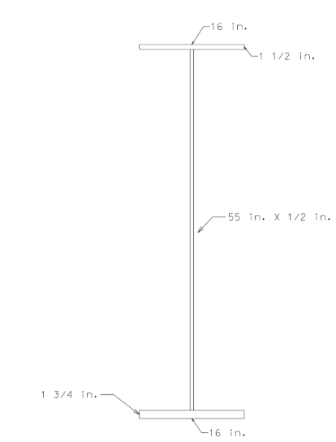
Final Design
Steel Plate Girder – AASHTO M 270 (ASTM 709M)
Grade 50 steel
Top Flange
16”x 1 ½”
Web
55” x ½”
Bottom Flange
16” x 1 ¾”
Girder spacing
9 feet center to center

Slide 18
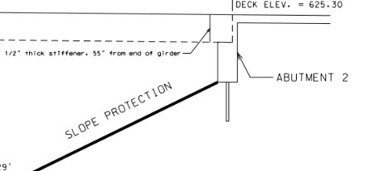
Final Design
Longitudinal stiffener
½” thick
4 ½” wide
55” deep
Located 55” from abutment
Shear studs
50 studs every 9”
Transition to 12” spacing
Diaphragms
W30 x 90
31.25 feet apart

Slide 19
Final Design
Elastomeric bearing pads
18” x 20” x 5.875”
1/8” thick internal steel plates
Bridge Deck
8” thick reinforced concrete deck
¼” integral wearing surface
Total deck thickness of 8 ¼”
Compressive strength of 4 ksi
Reinforced with #5 steel reinforcing bars
Parapets
WVDOT Type F barrier
Minimum height of 32”

Slide 20
Plate Girder Costs
Steel Plate Girders: grade 50, 125’ long $343,669
Steel Plate Girder Installation $102,817
Shipping for Steel Plate Girder $35,483
Steel Plate Girder Misc. $34,573
( Bolts, Plates, stiffeners,
sheer studs, etc.)
Total Cost for Steel Plate Girders $516,542

Slide 21
Final Costs
Class H concrete Deck:
Includes material, equipment, and labor $367,528
Deck:
Rebar including material and labor $22,447
Standard Type V Barrier:
Includes material, equipment, and labor $38,475
Elastomeric Bearing Pad:
5/8" T layers w/ 5.875" T total $12,648

Slide 22
Final Costs
Concrete Class H Haunches: $16,158
Splice Connection Installation: $4,701
Crane- 40 Ton
Predicted Project Cost: $985,000

Slide 23
Questions?

